Slide 1



All CATs are grey
in the dark
A novel approach to evaluating
computer adaptive tests (CATs) in the real world
Chris Gibbons
Director of Health Assessment and NIHR Fellow
The Psychometrics Centre
Cambridge Centre for Health Services Research
University of Cambridge

Slide 2
Key issues
Feedback is crucial (e.g., Krageloh et al 2015, Kosinski et al, 2013)
Clinicians uncertain of CAT evidence
‘Real world’ evidence is lacking
CAT causes a loss of item-level information

Slide 3
CAT Predictions
more engaging assessments
1
2
validate CATs in practice
3
predict responses
to unseen questions

Slide 4
Predictive validity
Information from items answered in CAT
(Person location/Ѳ)
Predict response to unanswered questions
Feedback predictions to patient and clinician
Elicit reports on prediction accuracy

Slide 5

WHOQOL adaptive test
Physical, psychological, social, and environmental QoL.
4000 people (320 from the UK).
Partial credit model parameters, no DIF for UK sample, all assumptions of the model met.
Simulated CAT using 1000 iterations based on experimental theta values.
Stopping rules related to standard error of .32, .45, and .55
(Reliability .90,.80 and .70) and matched reliability of paper WHO measures.
Gibbons, et el. (2016). Electronic quality of life assessment using computer-adaptive testing. JMIR. 18(9):e240

Slide 6
WHOQOL adaptive test
reliability .90
reliability .80
reliability .70
9 Items
4 Items
2 Items
82% shorter
than WHOQOL-100
46% shorter
than WHOQOL-BREF
Gibbons, et el. (2016). Electronic quality of life assessment using computer-adaptive testing. JMIR. 18(9):e240

Slide 7
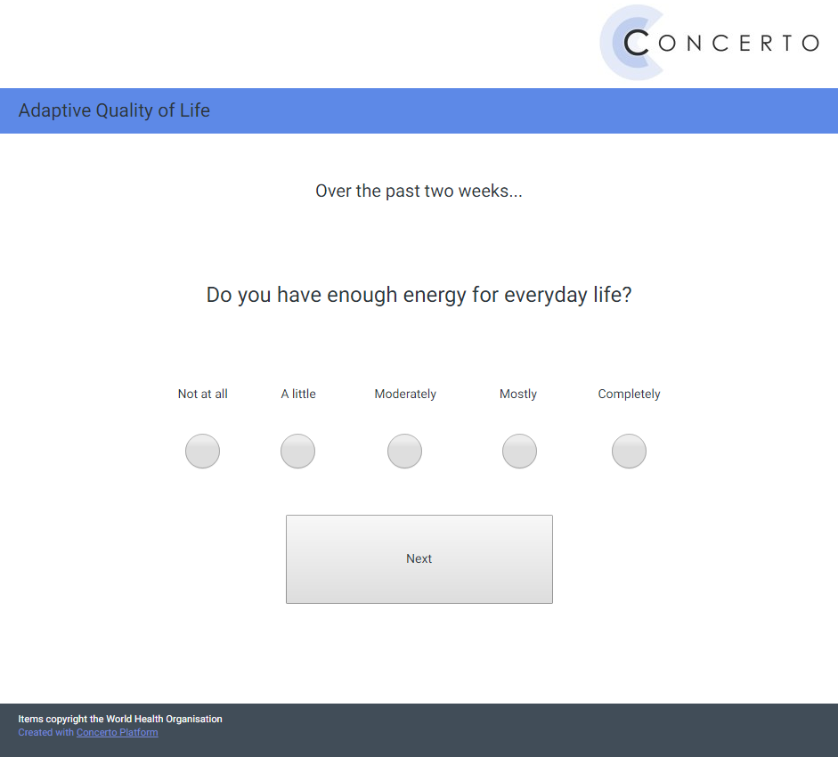
Concerto
Four item banks
Partial credit model
Maximum likelihood score estimation
Scaling parameter 1.7
Stopping rule of SE=.45
~Four items per bank

Slide 8
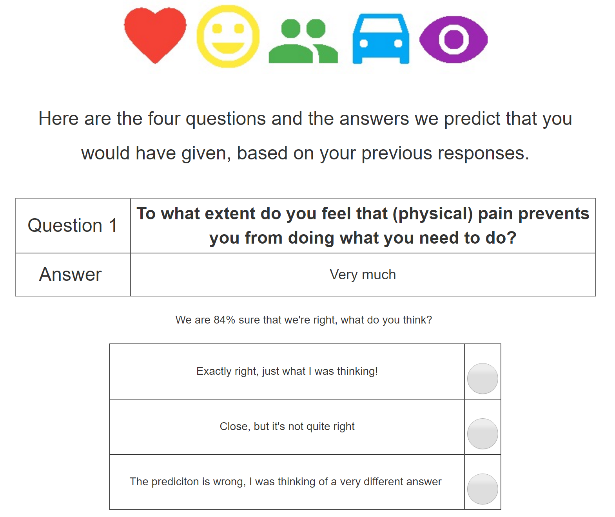
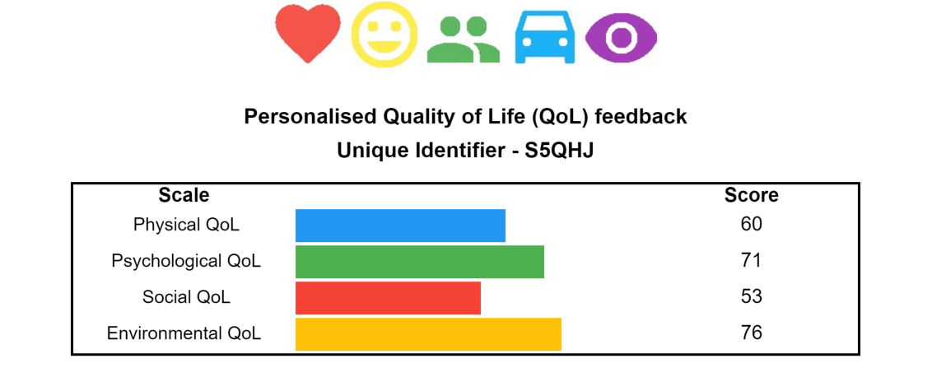
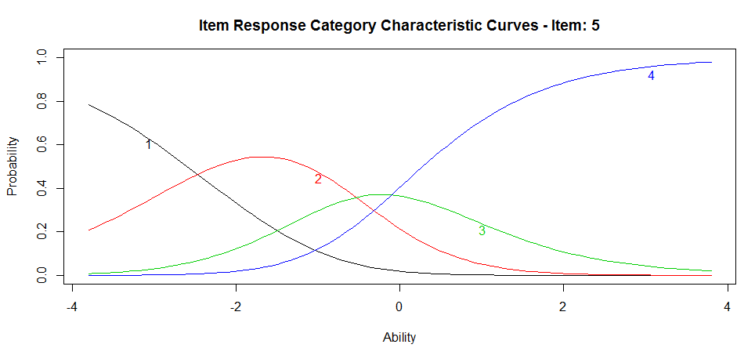
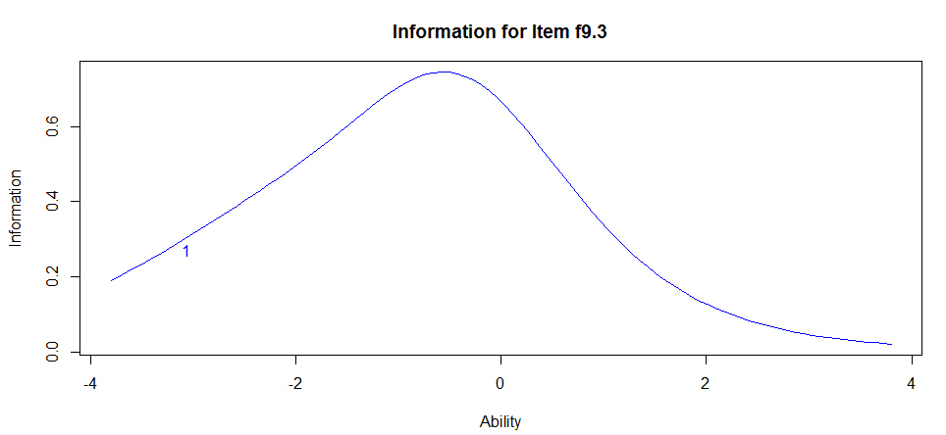
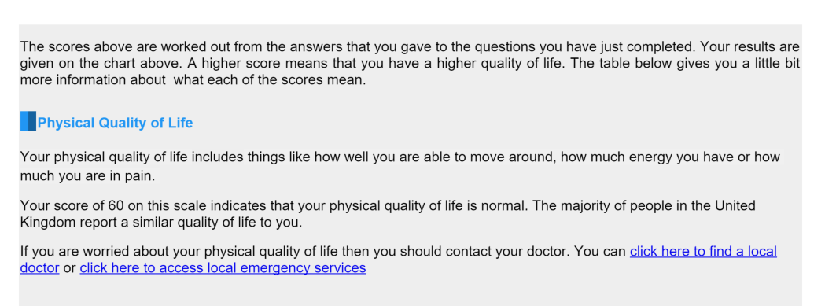
“All CATS” assessment flow
CAT completed until stopping rule was met (SE=.45)
Predictions made using person score estimate
Predictions fed back to participant/patient
Text/graphical feedback

Slide 9
Sample
1238 participants
97countries
311UK
70chronic conditions
45years old
56%male

Slide 10
Predictions
“I am satisfied with my life”
Quality of life

Slide 11
Predictions
“I am satisfied with my life”
Strongly agree 70%
Quality of life
Person location (Ѳ) = 1

Slide 12
Predictions
“I am satisfied with my life”
Agree 25%
Quality of life
Person location (Ѳ) = 1

Slide 13
Predictions
“I am satisfied with my life”
Disagree 4%
Quality of life
Person location (Ѳ) = 1

Slide 14
Predictions
“I am satisfied with my life”
Quality of life
Pi() function in `catR`. Implemented in Concerto

Slide 15
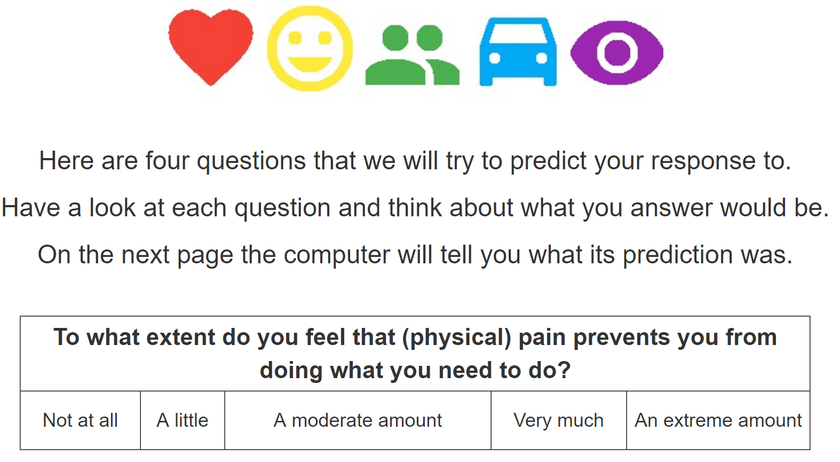
`
Prediction feedback

Slide 16
`
Tailored feedback

Slide 17
Results
1244
predictions

Slide 18
Results
79%
average expected accuracy of predictions

Slide 19
Results
69%
participants from the UK rated the predictions as “Exactly right”

Slide 20
Results
25%
participants from the UK rated the predictions as “Close, but not quite right”

Slide 21
Results
7%
participants from the UK rated the predictions as “Wrong”

Slide 22
PREDICATE
Responses to item f9.3 “How much do any difficulties in mobility bother you?” predicted 43 times
Category “Not at all” selected for persons located between θ 1.01 and
θ 2.18
Expected accuracy between 70% and 90%
34 “Exactly right” (79%)
5 “Close” (12%)
4 “Wrong” (9%)

Slide 23
PREDICATE
Responses to item f9.3 “How much do any difficulties in mobility bother you?” predicted 43 times
Category “Not at all” selected for persons located between θ 1.01 and
θ 2.18
Expected accuracy between 70% and 90%
34 “Exactly right” (79%)
5 “Close” (12%)
4 “Wrong” (9%)

Slide 24
PREDICATE
Responses to item f9.3 “How much do any difficulties in mobility bother you?” predicted 43 times
Category “Not at all” selected for persons located between θ 1.01 and
θ 2.18
Expected accuracy between 70% and 90%
34 “Exactly right” (79%)
5 “Close” (12%)
4 “Wrong” (9%)

Slide 25
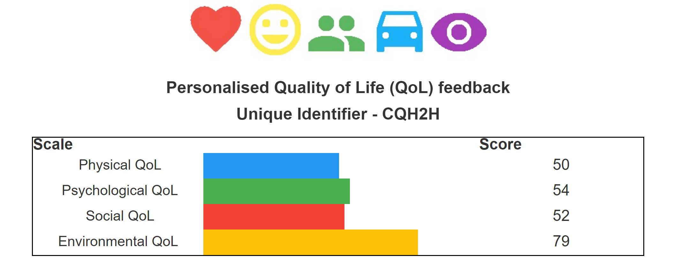
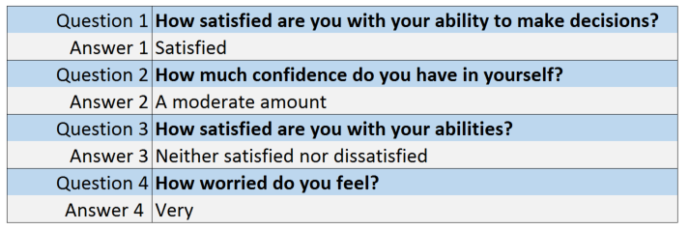

Current feedback
Responses to unasked questions?

Slide 26
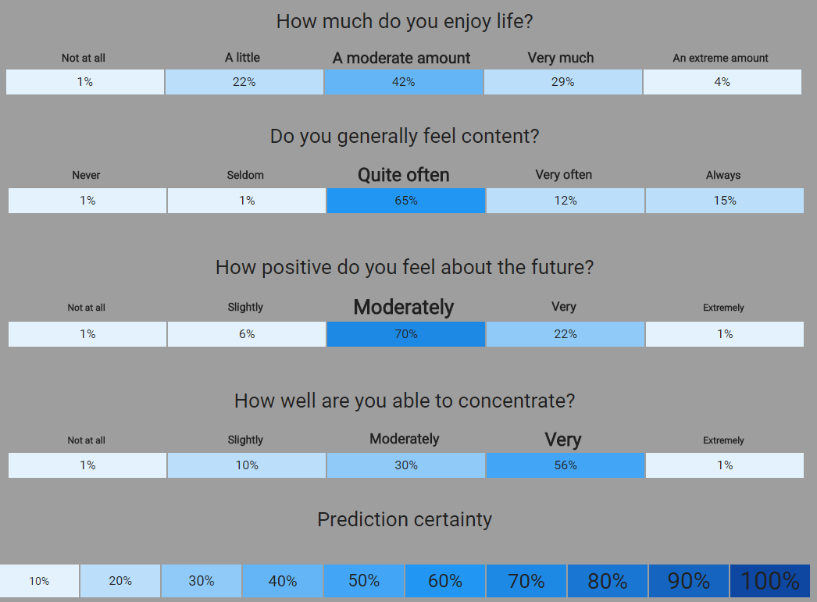
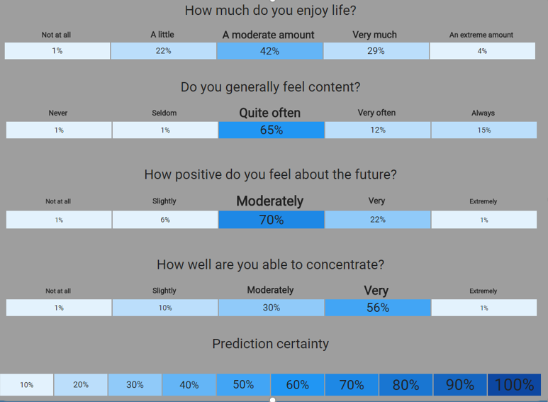
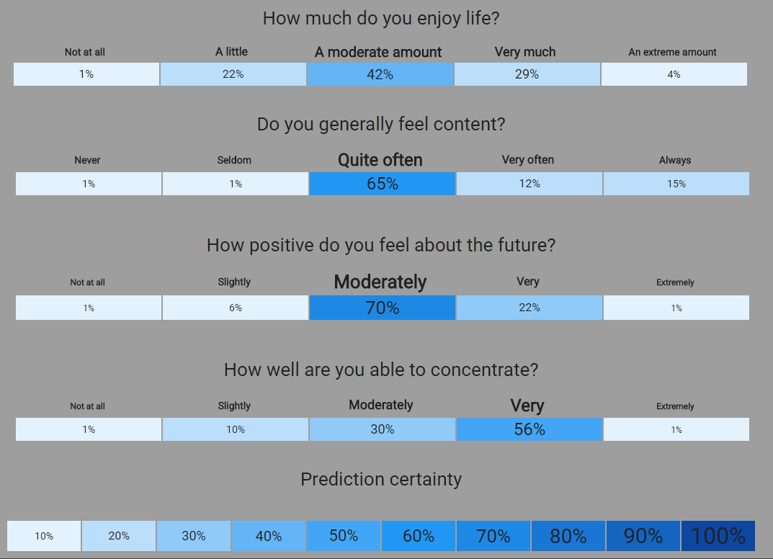
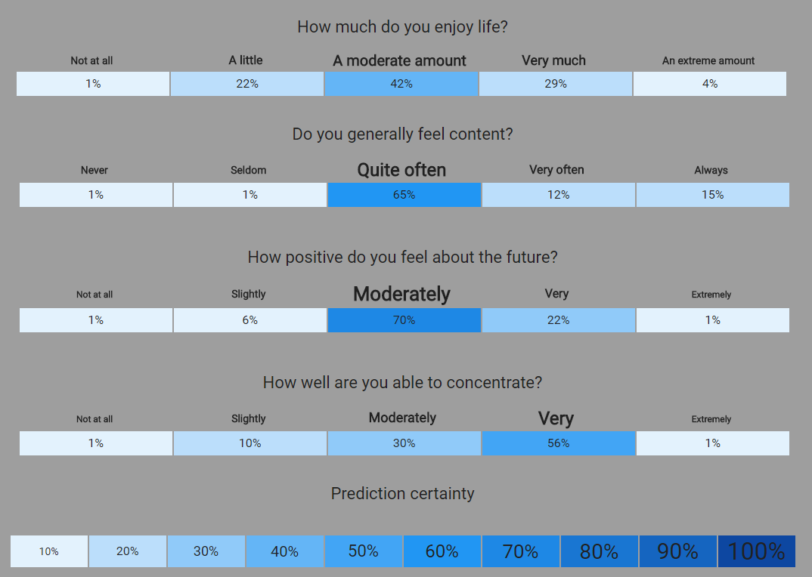
Predicted responses

Slide 27
Conclusions
93% of participants agree with predictions, or think they are ‘close’
Low misclassification rate (7%)
Accuracy within expected bounds
Patients can feedback on their feedback
Feedback to clinician can include predictions about unseen questions

Slide 28
Future steps
Assessing acceptability of feedback for patients and clinicians
Developing statistical assessment (rather than patient-reported)
“Join the team”- all code is freely available with support for implementation in Concerto

Slide 29

concertoplatform.com

Slide 30

Thank you
predictmyqol.com
concertoplatform.com
psychometrics.cam.ac.uk
@drcgibbons
@campsych
@cam_concerto
cg598@cam.ac.uk
Source code and slides:
github.com/chrisgibbons

Slide 32
`
Feedback hypothesis
Most boring
Most engaging
?
Nothing
Score only
Normative score
Normative score with
explanation
Normative score with
explanation
and prediction

Slide 34

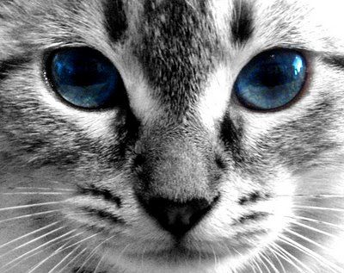
Computer adaptive testing_
Item bank
Computer adaptive test
Patient/
participant
1
2
3
4
6
5
7
8

Slide 35
Computer adaptive testing_
Item bank
Computer adaptive test
Patient/
participant
1
2
Best item
3
4
6
5
7
8

Slide 36
Computer adaptive testing_
Item bank
Computer adaptive test
Patient/
participant
2
1
3
4
6
5
7
8

Slide 37
Computer adaptive testing_
Item bank
Computer adaptive test
Patient/
participant
2
1
1
3
4
Item
6
5
7
8

Slide 38
Computer adaptive testing_
Item bank
Computer adaptive test
Patient/
participant
2
1
1
3
4
6
5
Response
7
8

Slide 39
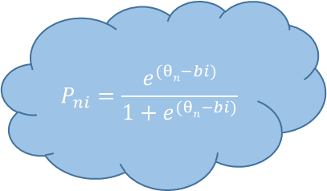
Quality of life estimate = 20
Reliability .70 .80 .90
Computer adaptive testing_
Item bank
Computer adaptive test
Patient/
participant
2
$$P_{ni}=\frac{e^{(θn−bi)}}{1+e^{(θn−bi)}}$$
1
1
3
4
6
5
Response
7
8

Slide 40
Quality of life estimate = 20
Reliability .70 .80 .90
Computer adaptive testing_
Item bank
Computer adaptive test
Patient/
participant
2
Best item
1
3
4
6
5
7
8

Slide 41
Quality of life estimate = 50
Reliability .70 .80 .90
Computer adaptive testing_
Item bank
Computer adaptive test
Patient/
participant
2
1
3
4
Item
6
5
Response
7
8

Slide 42
Quality of life estimate = 60
Reliability .70 .80 .90
Computer adaptive testing_
Item bank
Computer adaptive test
Patient/
participant
2
1
3
4
Item
6
5
Response
8
7

Slide 43
Quality of life estimate = 55
Reliability .70 .80 .90
Computer adaptive testing_
Item bank
Computer adaptive test
Patient/
participant
2
1
3
Item
6
5
Response
8
7
4

Slide 44
Quality of life estimate = 55
Reliability .70 .80 .90
Computer adaptive testing_
Item bank
Computer adaptive test
Participant
₂
1
3
Item
6
₅
Response
8
7
4

Slide 45
Quality of life estimate = 55
Reliability .70 .80 .90
CAT Validation_
Computer adaptive test
Simulations
Lab-based
External
Real world
Patient-centred
Internal
Engaging

